Slide 1
On-the-fly Validation of Hierarchical Cache Coherence Protocols using Directed Testing
Abhinaba Chakraborty^{1,2} Ansuman Banerjee¹ Vinay B.Y. Kumar² Arindam Mallik²
¹Indian Statistical Institute, Kolkata
²imec, Kapeldreef 75, 3001 Leuven, Belgium
Notes:
Hi, I am Abhinaba. In this slide I will present our work, “On-the-fly validation of Hierarchical Cache Coherence Protocols using Directed Testing”. This work is joint collaboration of Indian Statistical Institute, Kolkata and imec, Leuven.

Slide 2
Outline
Introduction
Background
Our Approach
Results
Conclusions & Future Work

Slide 3
Introduction
Caches
Main memory is slow
Caches are smaller but faster than main memory
Use the concept of temporal locality and spatial locality
Instruction and Data caches have contributed significantly to enhancing execution speed
Notes:
As we all know, main memory is slow. To tackle the main memory, caches are introduced. Caches are fast, smaller memort and uses the concept of temporal and spatial locality to enhance the execution speed.

Slide 4
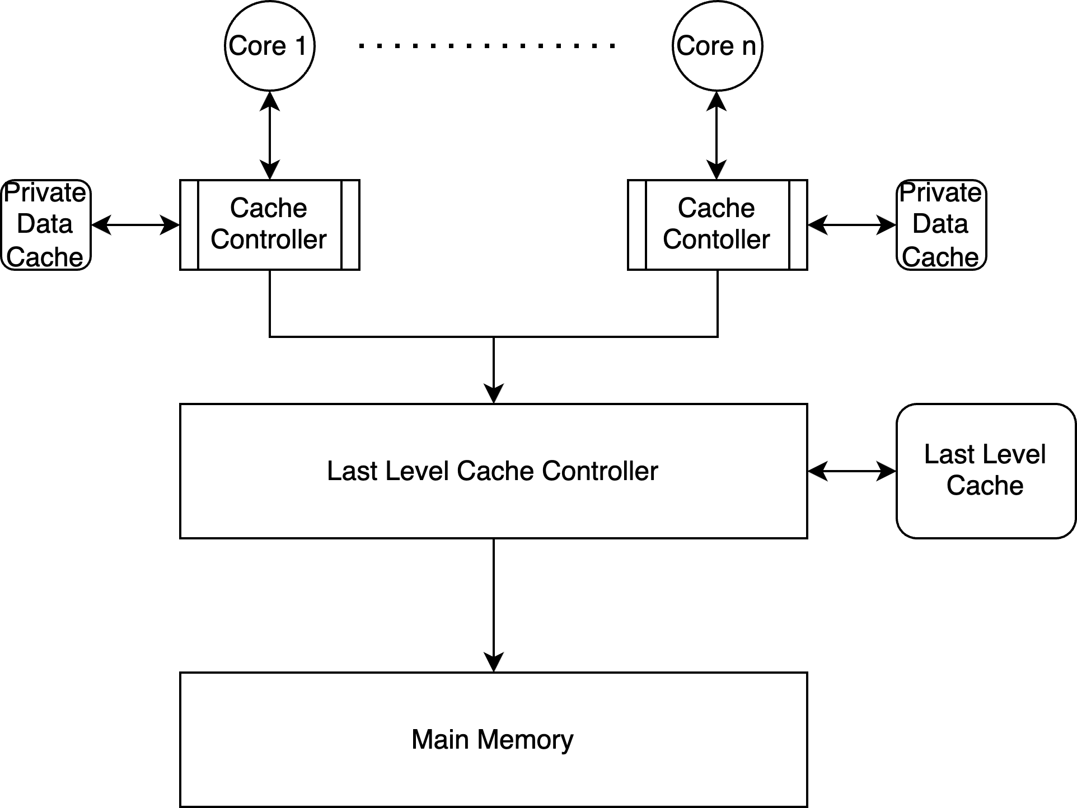
introduction
Multi-core Processors
Modern processors have multiple cores (4,6,8,16,32 cores)
Each core has its private cache
At the last level of the memory hierarchy, we have main memory
Enhanced concurrency, useful for simultaneous thread execution/ parallel workloads - different threads executing on different cores sharing a set of common variables

Slide 5
BACKGROUND

Slide 6
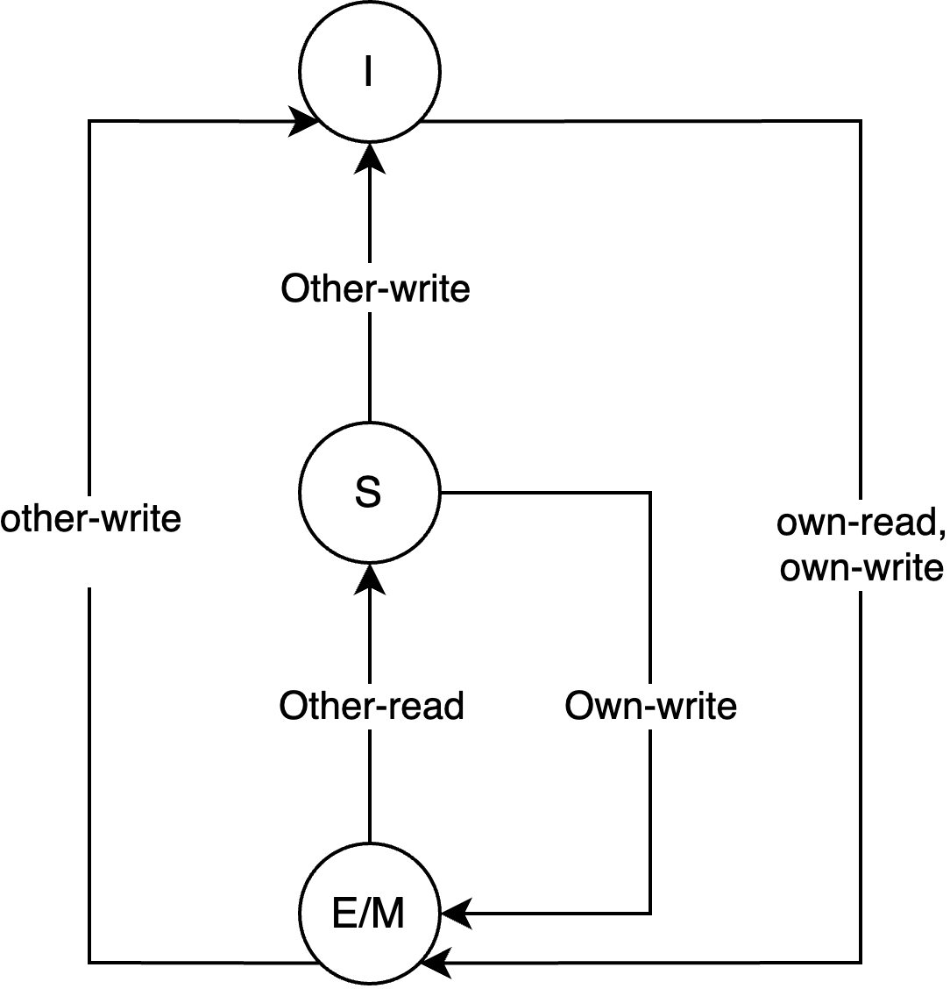
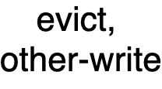


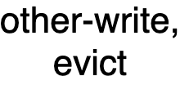








BACKGROUND
Cache coherence Protocols in multi-core processors
A set of rules that define the behaviour of the cache controller upon receiving a request from a core.
An FSM can represent this behaviour for each memory block and each cache block
MESI Protocol – Cache Controller
MESI Protocol – Memory Controller

Slide 7
BACKGROUND
Cache coherence verification – Related Work
Formal Verification
  Explicit State Analysis by Dill et al. ICCD 1992
  BDD-Based Methods
Simulation-based approaches
  Random Tests, Wood et al. IEEE D&T 1990
  Template-based Adir et al. IEEE D&T 2004
Directed Test Generation
  Breadth-first-search ( BFS )
  Pravat Mishra et al. TCAD 2018
Exponential increase in space
Limits the applicability in actual implementation
Randomness
Difficulty in reaching the global coverage goal

Slide 8

BACKGROUND - Directed Tests for SI cache coherence
Need to validate all possible configurations and interleaves of reads and writes / evictions
Need to consider the states and transitions of the composed FSM
Each request issued by a core, at least one transition in the Hypercube is covered
Need to generate tests to cover ALL states and transitions of the global Hypercube– Our goal
ISS
Core 1
Core 2
Core 3
IIS
ISI
Evict
Evict
Evict
III
Read
Read
Read
S
I
S
I
S
I
SSS
SIS
SSI
SII

Slide 9
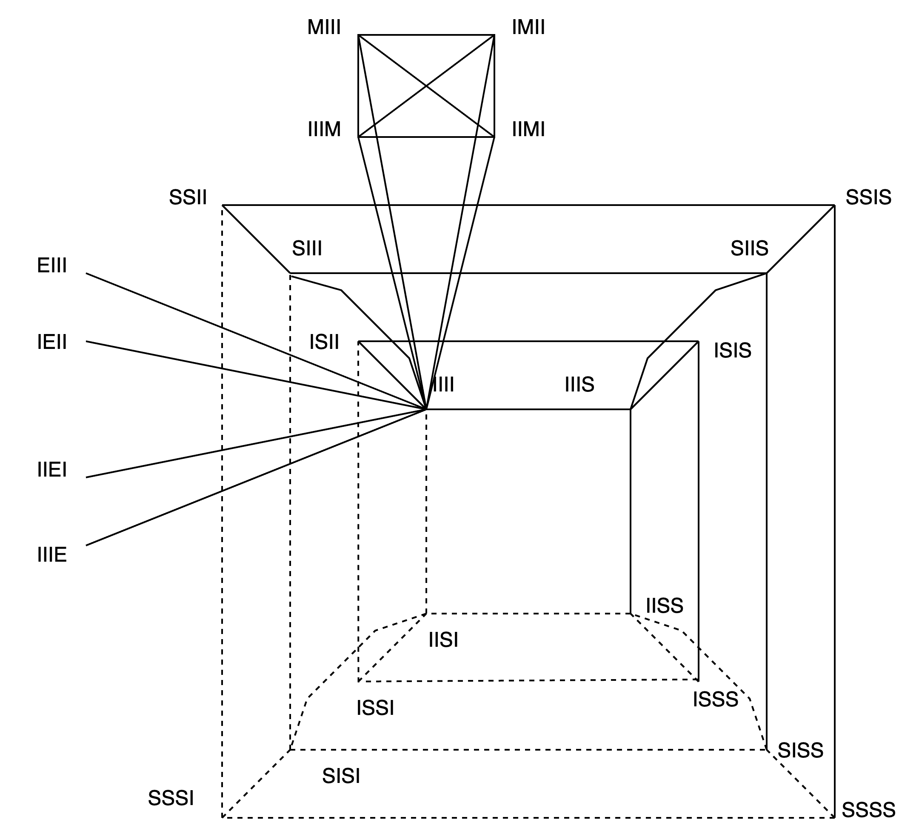
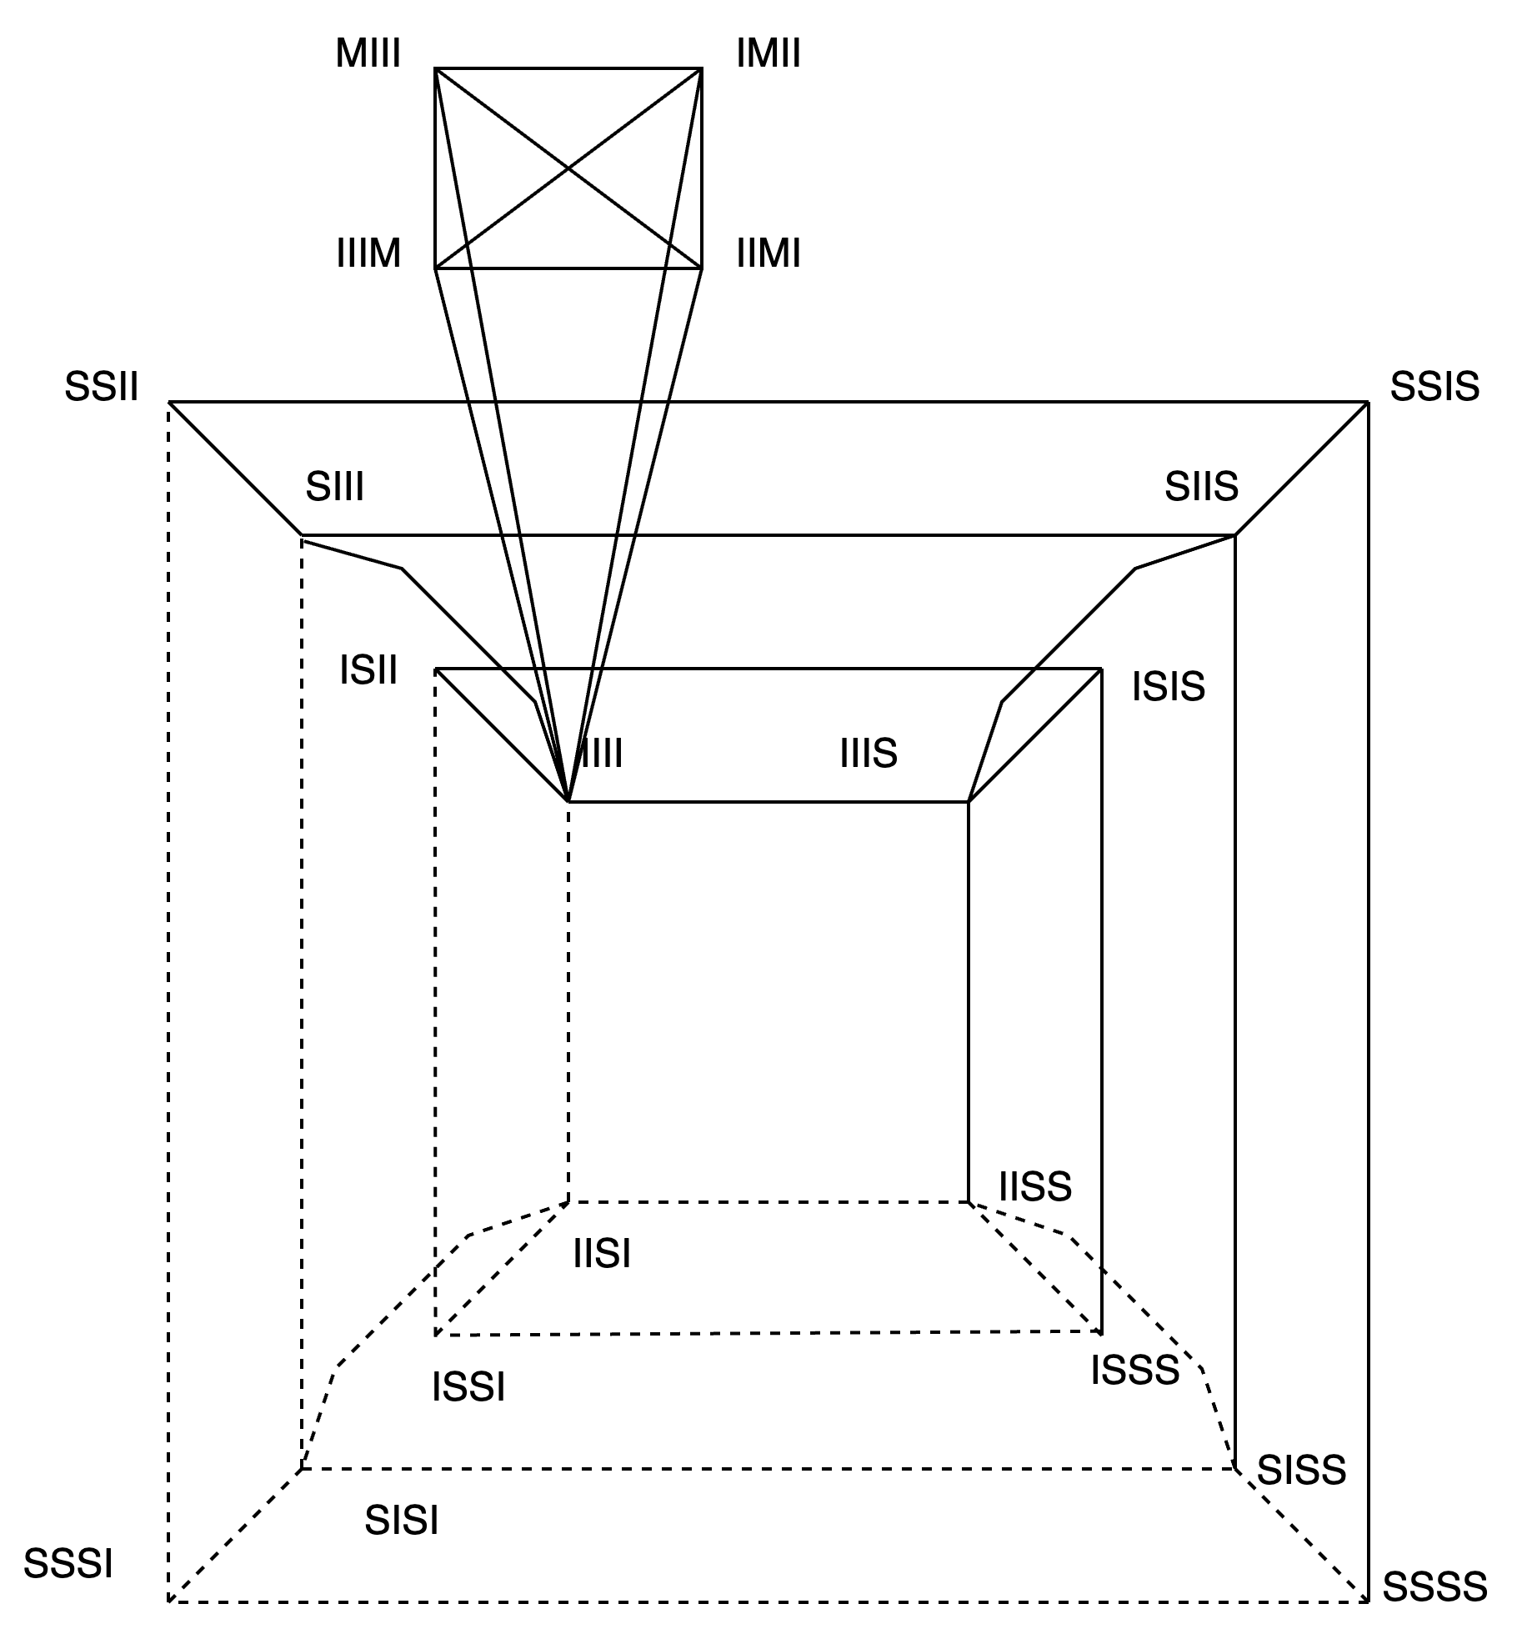
BAKGROUND
Terminologies
Global FSM for MESI Protocol
Global States ( IIII, ISII )
Global Invalid States ( IIII )
Global Shared States ( ISII, SSII )
Global Exclusive States ( EIII, IIIE )
Global Modified States ( MIII, IMII )
Global FSM for MSI Protocol

Slide 10
BACKGROUND
Cache coherence verification – Directed Tests
A
A
B
B
Random Tests
Directed Tests

Slide 11
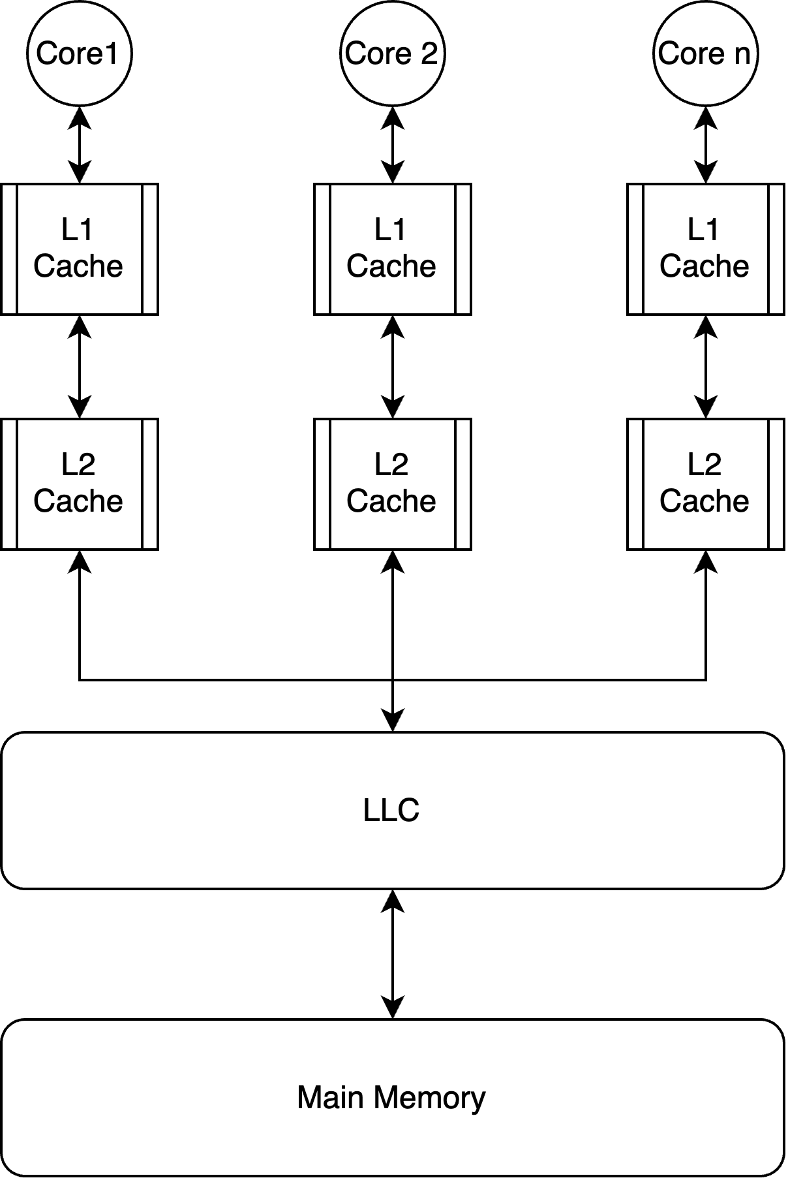
Multi-level caching – ISSUES with directed testing
ISSUES with Directed testing of multi-level caching
State-space Explosion:
  An exponential number of states with an increasing number of levels and caches
Issue of Missing States:
  For the MESI protocol, some of the global states (e.g., IEI, IIE) may be missed due to the introduction of L2, L3, and so on.

Slide 12
OUR APPROACH

Slide 13
OUR APPROACH
Cover only L1 states
  No need to cover all the states of L1, L2 and so on. Cover only the states of L1. Any error in L2, L3 will eventually manifest into L1
  ( Addresses the state-space explosion problem)
Introduce the flush operation
  Flushes the cache block from all levels of the cache hierarchy.
  (Addresses the issue of missing states)

Slide 14
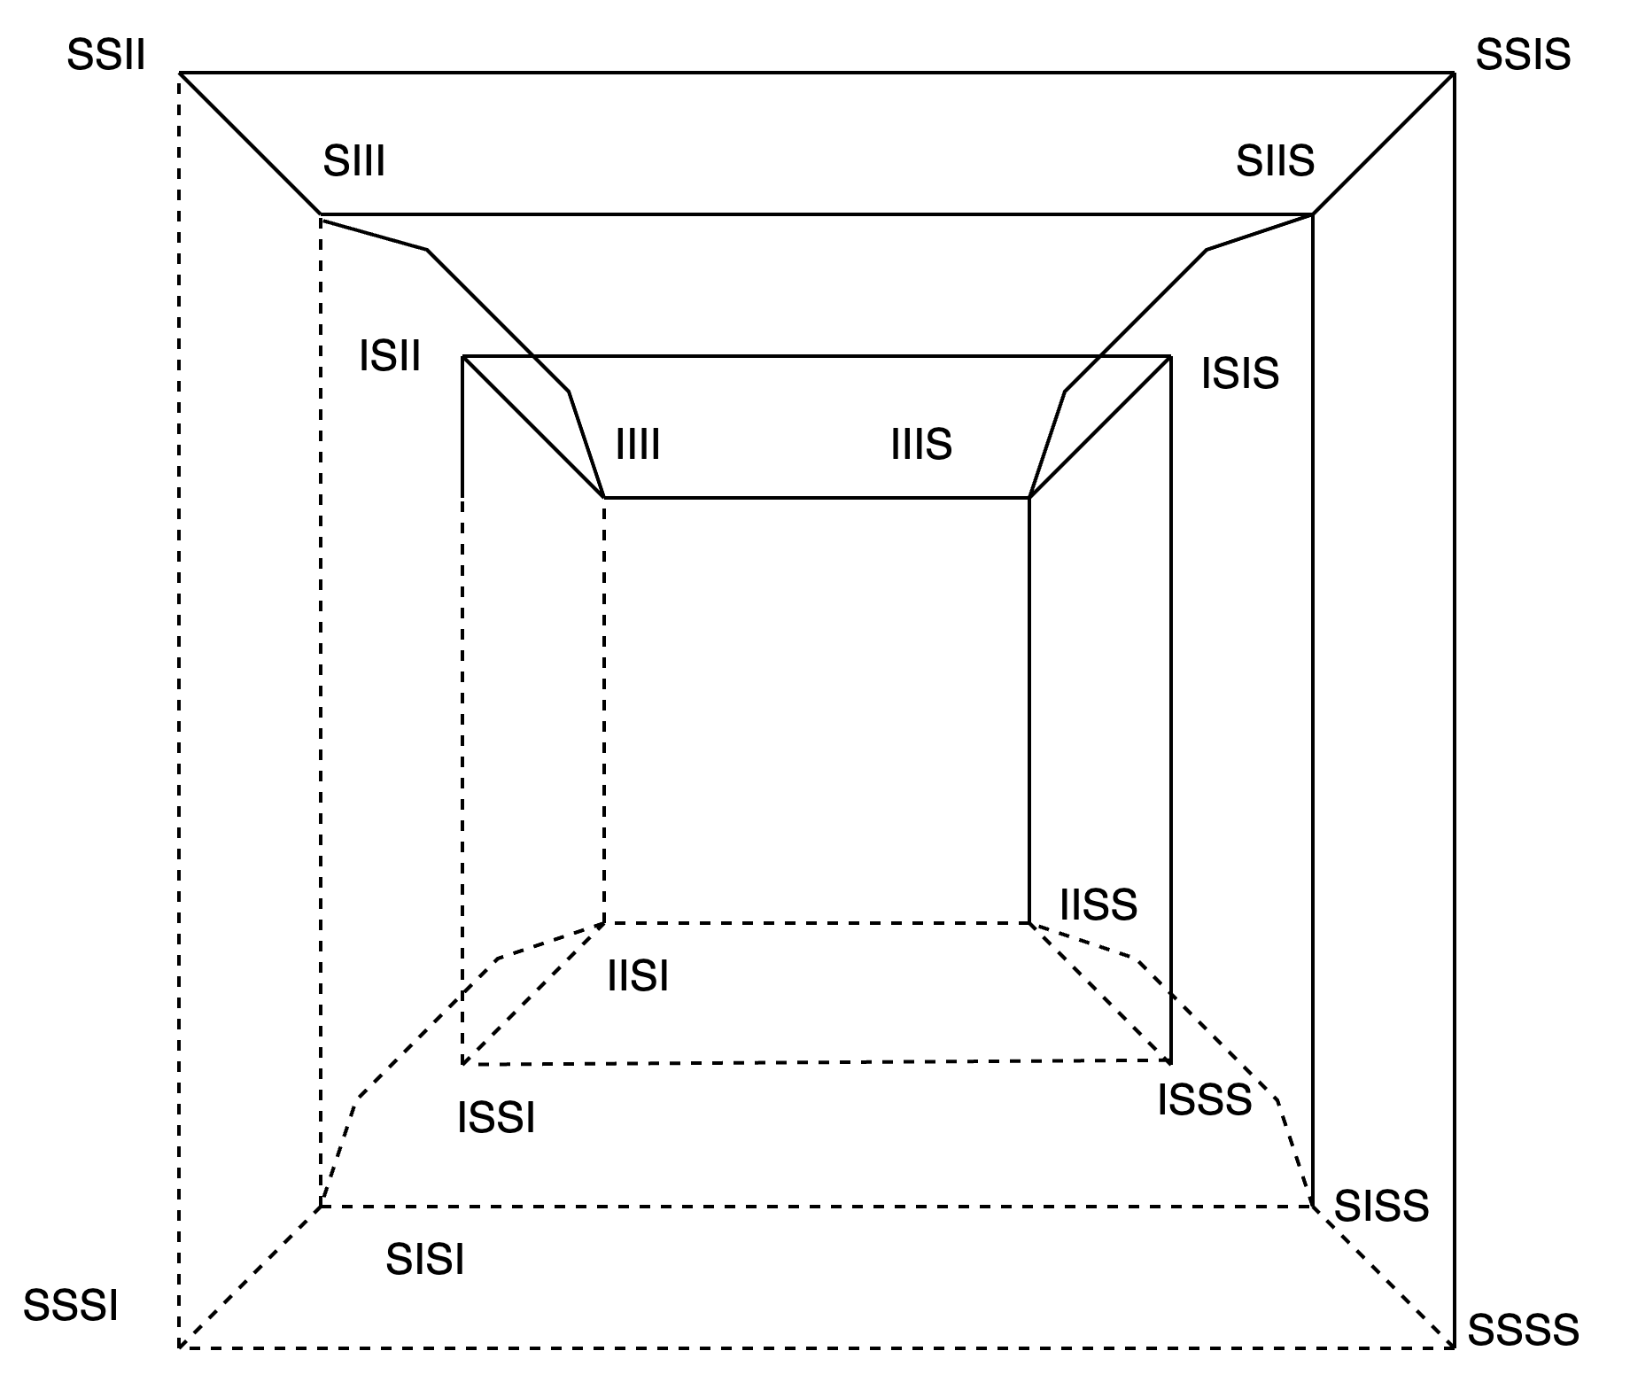
OUR APPROACH
Proposed Algorithm – SI Protocol
Notice that an n-hypercube can be divided into two isomorphic halves.
One instruction helps to cover two transitions of the global n-hypercube.
The idea is to do coordinated traversal of two components by the different cores, ensuring all states and transitions of the global FSM of a block are covered.

Slide 15
OUR APPROACH
Proposed Algorithm – MSI Protocol
Traversal for the hypercube
Traversal for the clique
Other transitions from S to M

Slide 16
OUR APPROACH
Proposed Algorithm – MESI Protocol
Traversal for the hypercube
Traversal for the clique
Other transitions from S to M
E to S states
E to M states

Slide 17
OUR APPROACH
EXPERIMENTAL SETUP
Used the Structural Simulation Toolkit (SST) for simulation and validation of our and other approaches
  Used Prospero, memHierarchy, and the Merlin module
SST has a built-in MSI and MESI cache coherence module
  For SI, we used write-through caches ( no need to issue a write instruction)
Implemented flush operation inside SST cache control elements
  Immediately invalidates all copies of the memory block for all caches and main memory
Implemented our tester as an SST component
  memHierarchyTester – ported from the Ruby Tester of Gem5

Slide 18
OUR APPROACH
Results
Protocol | 4 Cores | 6 Cores | 8 Cores
SI | 72.25 KB | 72.69 KB | 74.24KB
MSI | 72.15 KB | 72.15 KB | 72.15 KB
MESI | 72.47 KB | 72.85 KB | 74.4 KB
Memory requirement is low

Slide 19
OUR APPROACH
Results
50% fewer test cases.

Slide 20
Results
Finding Bugs
Well-known bug inside SST-13 – Read after Write Bugs
  https://github.com/sstsimulator/sst-elements/issues/1934
  memHierarchyTester – component for SST (inspired by Gem5 RubyTester)
Random Tester framework catches the bug in more than 1000 steps.
  MemHierarchyTester[performCallBack:314]: Action/check failure: proc 1444 at the
  address: 464, byte_number: 0, the expected value is 3f but received 99 instead.
  Time: 6002000
Directed testing framework catches the bug in less than 50 steps.
  MemHierarchyTester[performCallBack:314]: Action/check failure: proc 47 at the
  address: 0, byte_number: 0, the expected value is 75 but received 5d instead.
  Time: 4373000

Slide 21
Future Work

Slide 22
FUTURE WORK
Transient States
  What happens when two cores issue instructions at the same time?
Path coverage
  Any guarantee of path coverage?

Slide 24
APPENDIX

Slide 25
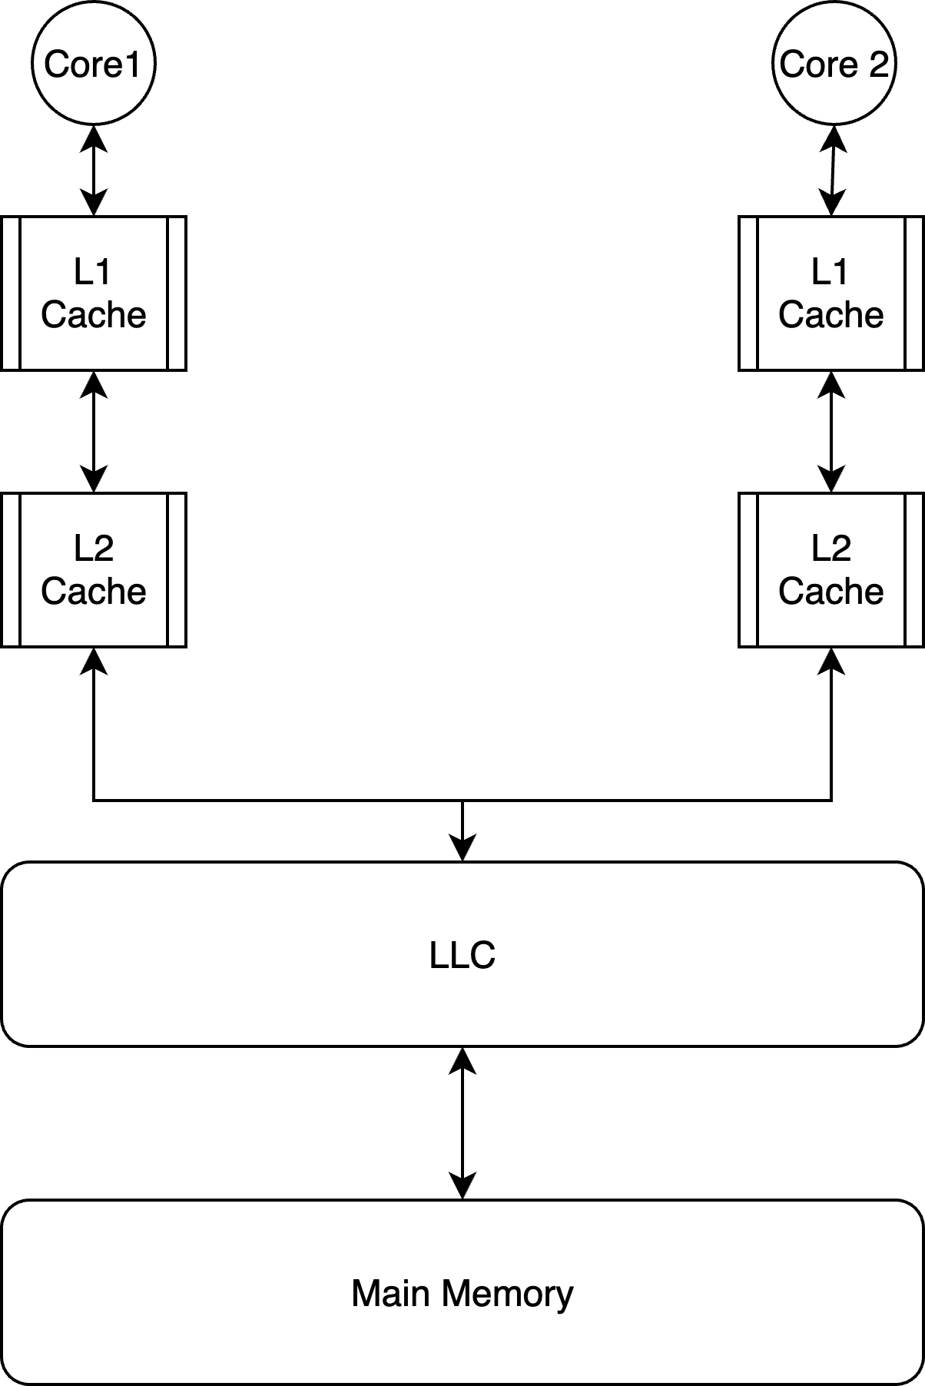
Multi-level caching – ISSUES with directed testing
Exponential number of states and transitions
II, II
IS, IS
II, IS
SI, S1
SS SS
SI, SS
II, S1
IS, SS
II, SS

Slide 26

Multi-level caching – ISSUES with directed testing
MISSING STATES – MESI protocols
Test Cases
  P0: Load B0
  P1: Load B0
  P1: Load B1
  P0: Load B1
  P1: Load B0
  …
II
EI
IS
SS

Slide 27
Our Approach – SI Protocol
Consider three cores (P1, P2, P3), all of which initially have an I state for the B0 memory block and an S state for the B1 memory block
Issue P2: Load B0
B0
B1
III
IIS
SSS
SSI
ONE instruction helps to cover TWO transitions of the global n-hypercube
Coordinated traversal of the two components by the different cores ensures all states and transitions of the global FSM of a block are covered

